Slide 1
Comics by Women
Presented by Eden Miller

Slide 2
Comics by Women
About me:
Ignatz Awards coordinator for Small Press Expo
Blogger for 10 years at www.comicsgirl.com
Trina Robbins’ Pretty in Ink, published by Fantagraphics

Slide 3
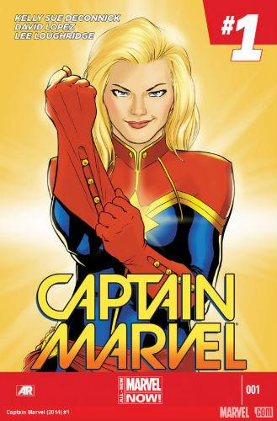
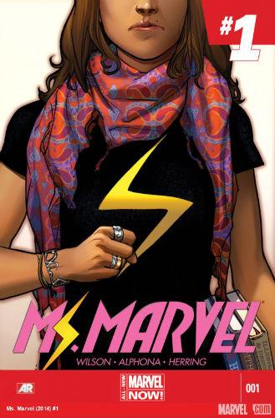
Mainstream comics: Superheroes
Kelly Sue DeConnick: Captain Marvel
G. Willow Wilson: Ms. Marvel
Gail Simone: Birds of Prey, Batgirl, Red Sonja

Slide 4
Mainstream comics: Sci-fi & Fantasy
Kelly Sue DeConnick and Emma Rios: Pretty Deadly
Grace Ellis, Noelle Stevenson, Brooke Allen: Lumberjanes
Carla Speed McNeil: Finder
Fiona Staples: Saga

Slide 5
Children and Young Adult Comics
Raina Telgemeier: Smile, Drama, Sisters
Faith Erin Hicks: The War at Ellsmere, Friends With Boys, The Adventures of Superhero Girl
Hope Larson: Chiggers, A Wrinkle in Time
Jennifer Holm: Babymouse

Slide 6
Autobiographical
Alison Bechdel: Fun Home and Are You My Mother?
Marjane Satrapi: Persepolis
Mari Naomi: Kiss and Tell, Dragon’s Breath
Ellen Forney: Marbles
Ulli Lust: Today is the Last Day of the Rest of Your Life
Nicole J. Georges: Calling Dr. Laura

Slide 7
Manga
Kyoko Okazaki: Pink, Helter Skelter
Moto Hagio: A Drunken Dream, The Heart of Thomas
Takako Shimura: Wandering Son
Moyoco Anno: In Clothes Called Fat, Insufficient Direction

Slide 8
UK, Europe and Around the World
Mary Talbot: The Dotter of Her Father’s Eyes, Sally Heathcoate: Suffragette
Isabel Greenberg: Encyclopedia of Early Earth
Julie Maroh: Blue is the Warmest Color
Marguerite Abouet: Aya series
Rutu Modan: Exit Wounds, The Property

Slide 9
Online comics
Molly Ostertag: Strong Female Protagonist
Allie Brosh: Hyperbole and a Half
Meredith Gran: Octopus Pie
Kate Beaton: Hark! A Vagrant
Danielle Corsetto: Girls with Slingshots
Kate Leth: Kate or Die!

Slide 10
Minicomics & cutting-edge creators
Seo Kim
Corinne Mucha
L. Nichols
Yumi Sakugawa
Andrea Tsurumi
Whit Taylor
Jen Vaughn
Jenn Woodall

Slide 11
Publishers, groups and events
Koyama Press
Team Girl Comic
Dirty Diamonds
Laydeez Do Comics
Drink & Draw Like a Lady

Slide 12
My Top Picks
of Comics by Women
for 2014

Slide 13
Can’t We Talk About Something More Pleasant
Roz Chast

Slide 14
How to Be Happy
Eleanor Davis

Slide 15
Operation Margarine
Katie Skelly

Slide 16
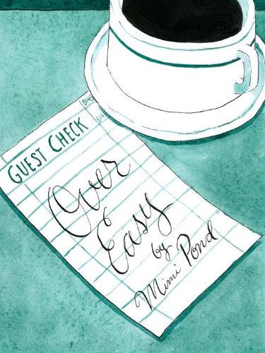
Over Easy
Mimi Pond

Slide 17
This One Summer
Jillian Tamaki
Mariko Tamaki

Slide 18
Through the Woods
Emily Carroll

Slide 19
Thank you!

